Slide 1

Automated Vehicle Monitoring System using OpenCV
Project Guide:
MR.PREMKUMAR R ASSISTANT PROFESSOR
M.E;
Team Members:
1.B.SARATH
2.A.YASWANTH
3.AKSHITH

Slide 2
Agenda
Title
Introduction
Objective
Existing System
Disadvantages
Proposed System
Literature Review
System architecture
MODULES/ LIBRARIES /PACKAGES
Module 1
Requirements
Conclusion
Output screenshot
Thank you

Slide 3
INTRODUCTION
An Automated Vehicle Monitoring System using OpenCV is a computer vision-based solution designed to track and monitor vehicles in real-time. OpenCV, which stands for Open Source Computer Vision Library, is a widely used open-source computer vision and machine learning software library. It provides a plethora of tools and functions that make it ideal for tasks like object detection, tracking, and image processing.
The goal of this system is to monitor and manage vehicles in various contexts, such as traffic surveillance, parking management, toll collection, and security applications.

Slide 4

OBJECTIVE
Computer vision on vehicles :
Our project detects vehicles and counts them in real time as well as in recorded videos.
Using this we can know the the traffic and moderate it.
We can extend it on micro processors and controllers too like Raspberry pi or Arduino.

Slide 5

EXISTING SYSTEM
Haar classifiers, classifiers that were used in the first real-time face detector. A Haar classifier, or a Haar cascade classifier, is a machine learning object detection program that identifies objects in an image and video.
The algorithm can be explained in four stages:
Calculating Haar Features
Creating Integral Images
Using Adaboost
Implementing Cascading Classifiers

Slide 6
DISADVANTAGES
High false-positive detection
Less accurate than deep learning-based techniques
Manual tuning of parameters.
Training haar cascade on a custom object is not easy.

Slide 7
PROPOSED SYSTEM
.
But our current Proposed project’s main objective is to reduce the occurrence of traffic jams by sending the count of vehicles to the traffic control office . So that they can be aware of the no.of vehicles are on road and accordingly they can make traffic signals and manage the traffic control.

Slide 8
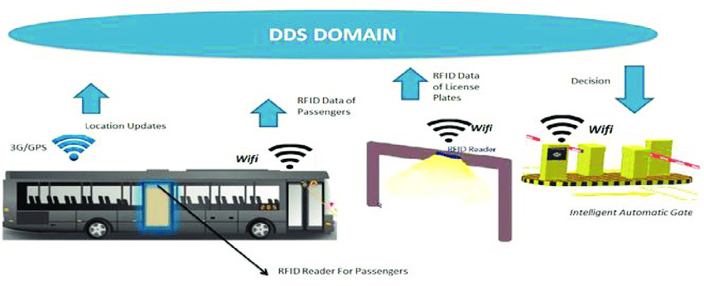
LITERATURE REVIEW
Automatic Vehicle Location and Monitoring System based on Data Distribution Service
Technologies Used: Bluetooth, Publish/Subscribe Model
This paper proposes a real time Automatic Vehicle Location (AVL) and Monitoring system for pilgrims road transport coming towards city of Makkah in Saudi Arabia based on Data Distribution Service (DDS). This service is a real time publish/subscribe middleware. Using this middleware approach, we are able to locate and track a huge number of mobile vehicles and identify pilgrims for an annual Islamic gathering in the Holy City of Makkah. Performance results are demonstrated for LAN, WLAN and Bluetooth over DDS.

Slide 9
LITERATURE REVIEW
A Survey of Vision-Based Vehicle Detection, Tracking, and Behavior Analysis
Technologies Used: sterio and active sensor vision
We detail advances in vehicle detection, discussing monocular, stereo vision, and active sensor-vision fusion for on-road vehicle detection. We discuss vision-based vehicle tracking in the monocular and stereo-vision domains, analyzing filtering, estimation, and dynamical models.

Slide 10




SYSTEM ARCHITECTURE
1. Image processing
1
2. Filtering backgrounds
DETECTION PROGRESSION
3. Frame processing and detection
4.Noting and reporting the count

Slide 11
LIST OF MODULES:
OPENCV
Vehicle detection

Slide 12
MODULE 1:
OPENCV:
OpenCV is a library of programming functions mainly aimed at real-time computer vision. Originally developed by Intel, it was later supported by Willow Garage then Itseez. The library is cross-platform and free for use under the open-source Apache 2 License.
Removes Background
Filters Images
Works on Frames to Produce Count

Slide 13
REQUIREMENTS:
Software Requirements:
2. Hardware requirements:
Python IDLE 3.10
Webcam
Microprocessor

Slide 14
CONCLUSION
We can monitor vehicles in real time on traffic roads by placing the camera on top view of road to monitor the no.of vehicles travelling.
The count of vehicles can be used for the road transportation survey.
It can also be used near borders to find anonymous vehicles.
Our project model also can be used to detect any moving objects.

Slide 15
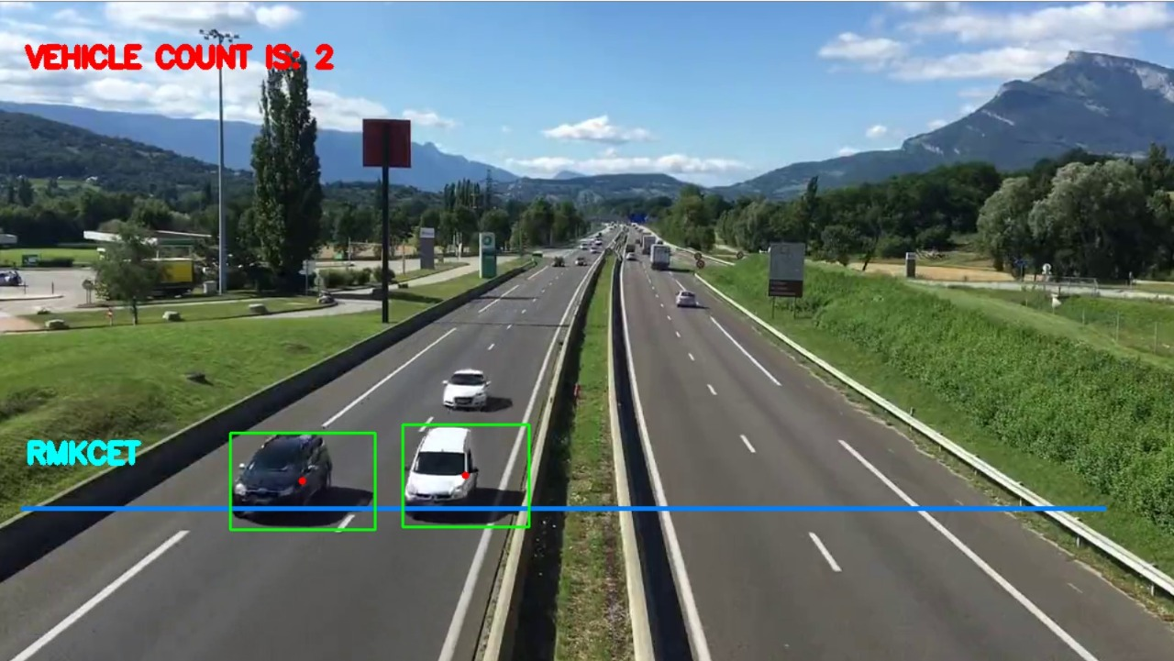
OUTPUT SCREENSHOTS:

Slide 16
THANK YOU

